Slide 1

Welcome!
2025 SART Planning Workshop

Slide 2
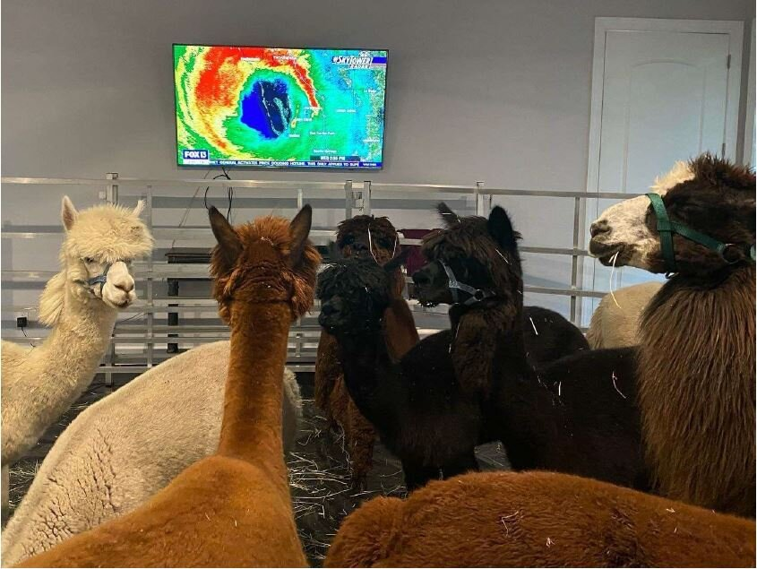
Don’t Forget to…Sign In!
Located in the foyer.
And pick up your registration package!!!

Slide 3
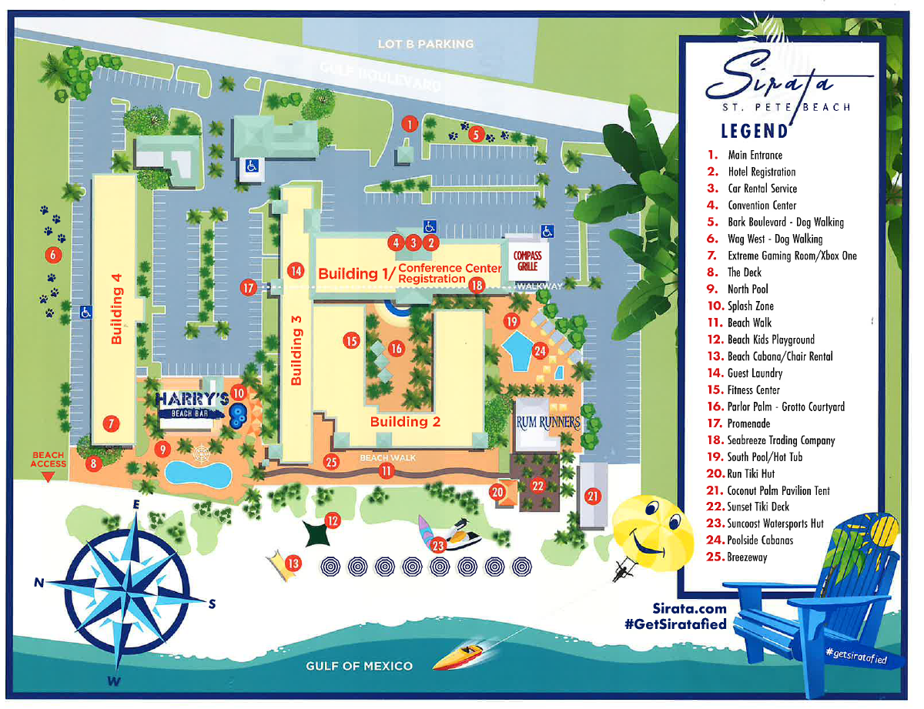

Slide 4
Pinellas County Emergency Management Agency
Stephanie Hendrix, Planning and Preparedness Manager, Pinellas County Emergency Management

Slide 5
Commissioner Wilton Simpson
Florida Department of Agriculture and Consumer Services

Slide 6
Florida ESF 17 and SART: Concept of Operations
LeiAnna Moorhead, Emergency Programs Manager and ECO ESF17, FDACS

Slide 7
Agricultural Protection and Security in Florida
Colonel Lee Adams, Office of Agricultural Law Enforcement, FDACS

Slide 8

Break/Booth Visits
10:00 am – 10:30 am
This break is sponsored by:
Thank you!

Slide 9
Agricultural Economic Impacts and Data Tools You Can Use for Threat Assessment
Dr. Christa Court, Associate Professor of Regional Economics & Director, Economic Impact Analysis Program, UF Institute of Food and Agricultural Sciences

Slide 10
Lunch on your own
11:30 am – 1:00 pm

Slide 11
Panel: Working with UF/IFAS Extension in Blue Skies & Beyond
Dr. Saqib Mukhtar, Professor and Associate Dean for Extension, UF Institute of Food and Agricultural Sciences

Slide 12
Food and Agriculture Sector Treats: Foreign and Emerging Animal Diseases
Dr. Tracie Guy, DVM, Veterinarian Manager, FDACS

Slide 13

Break/Booths Visits
3:00 pm – 3:30 pm
This break is sponsored by:
Thank you!

Slide 14
Florida Veterinary Corps: Building Community Partnerships with Veterinarians
Dr. Terry Clekis, DVM, Disaster Preparedness Committee Chair, Florida Veterinary Medical Association

Slide 15
The Hurricane Bonus Prize: The little surprise that “bugs” recovery efforts and what you can do about it.
Marah Clark, Environmental Administrator, FDACS

Slide 16
Captive Wildlife Critical Incident and Natural Disaster Response
Lt. Louis Hinds, Florida Fish and Wildlife Conservation Commission

Slide 17
Thank you!

